Slide 1




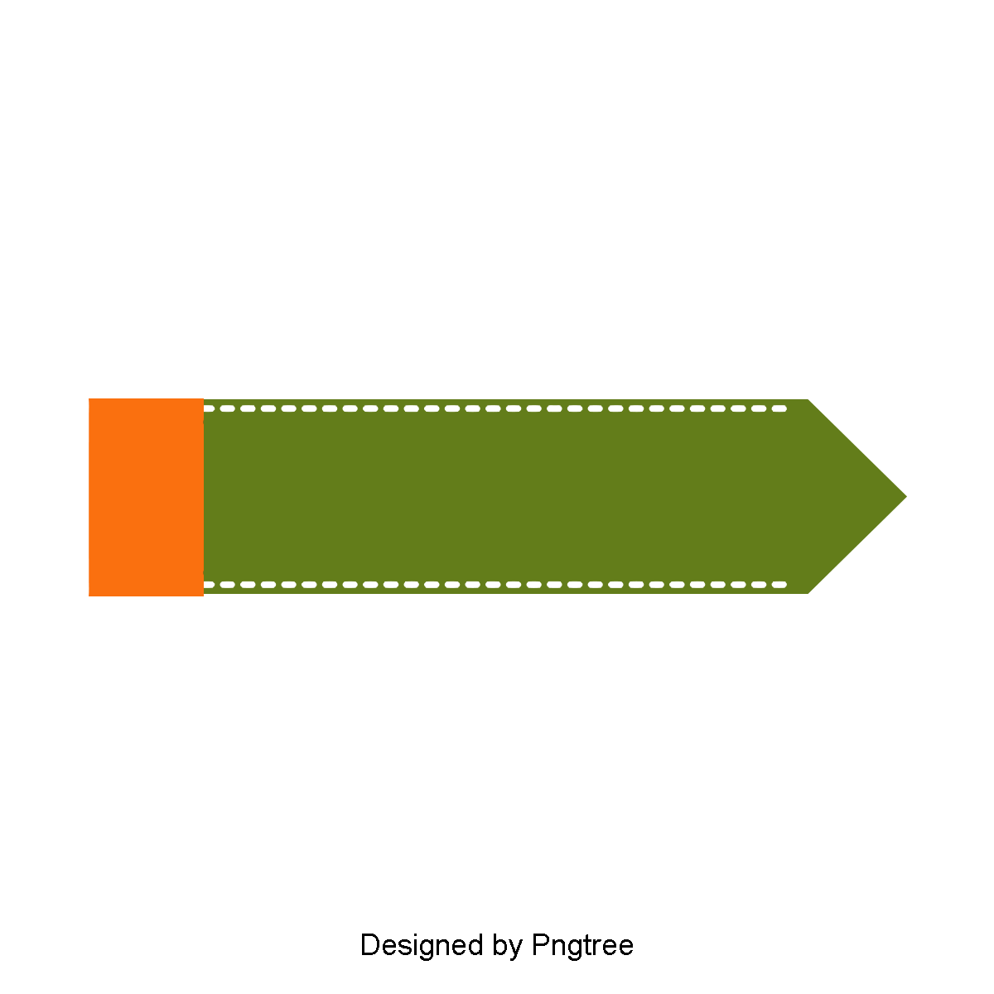



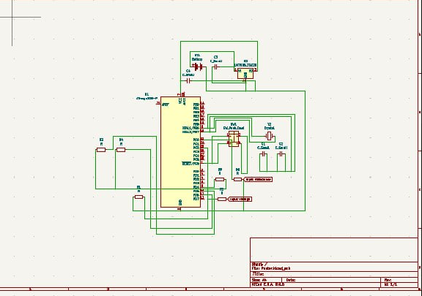
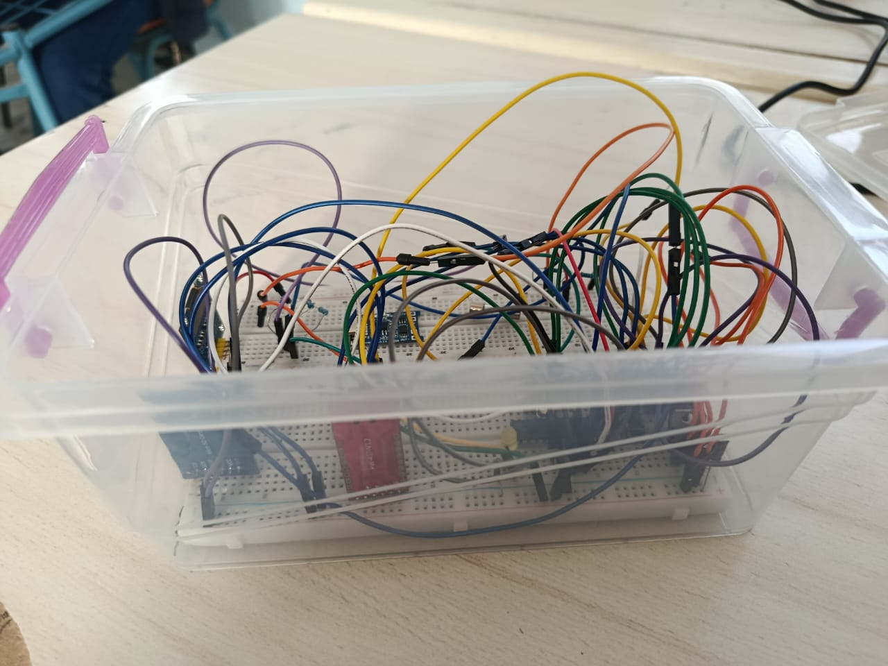
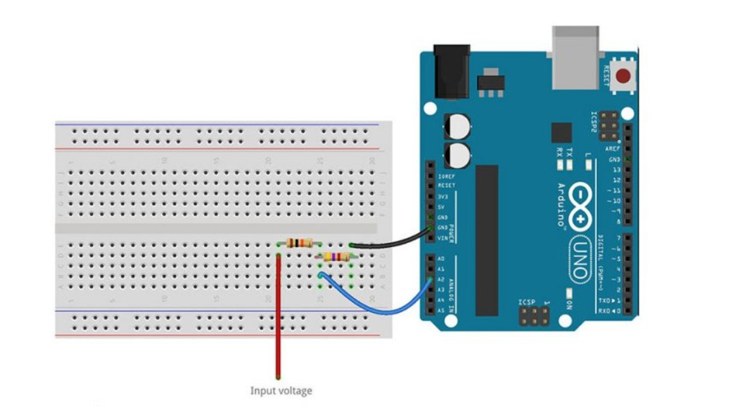
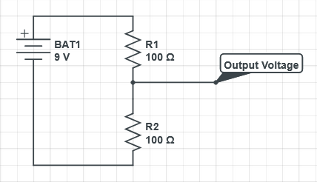


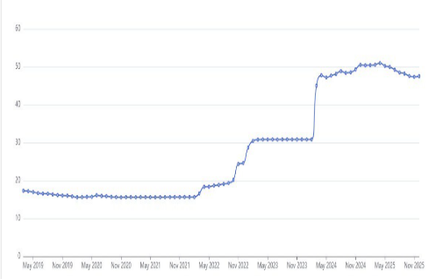
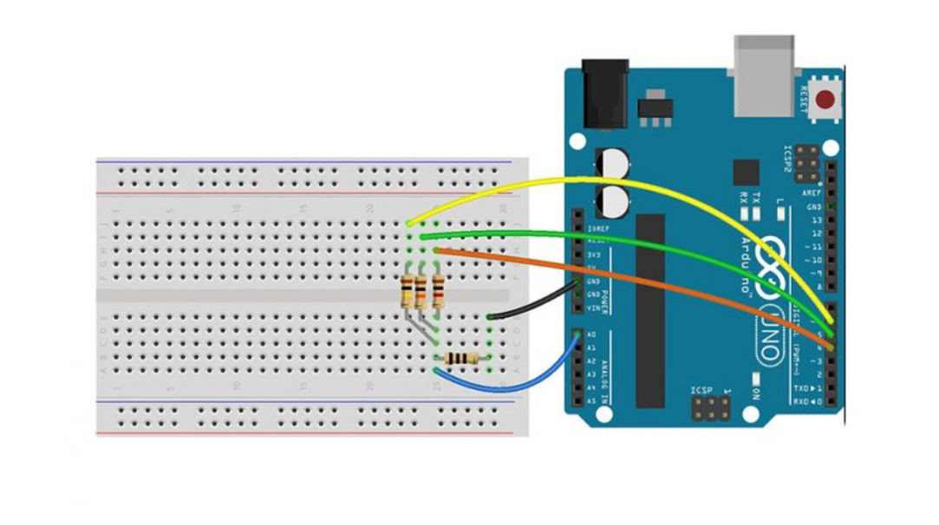


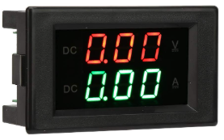

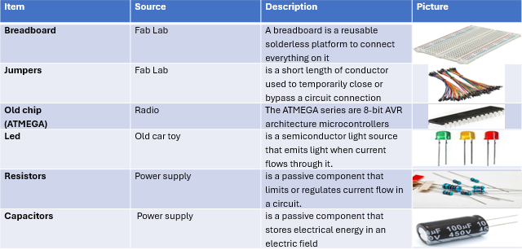
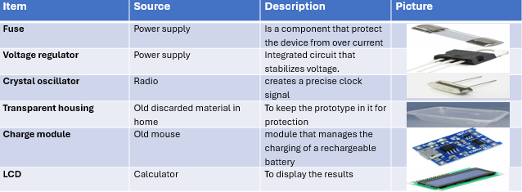

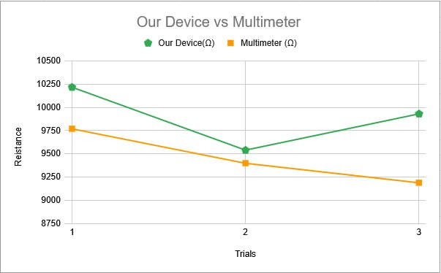
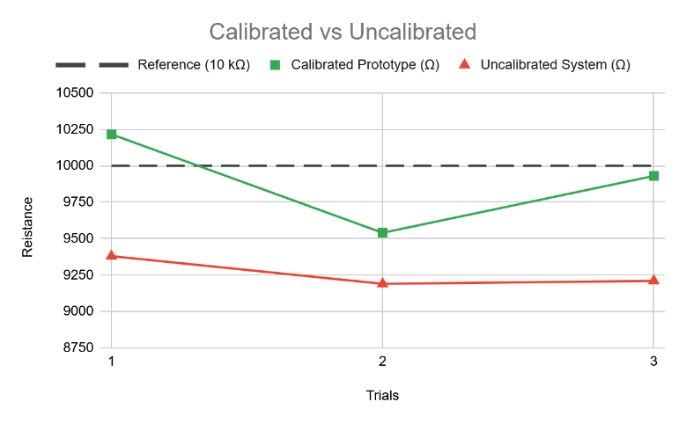



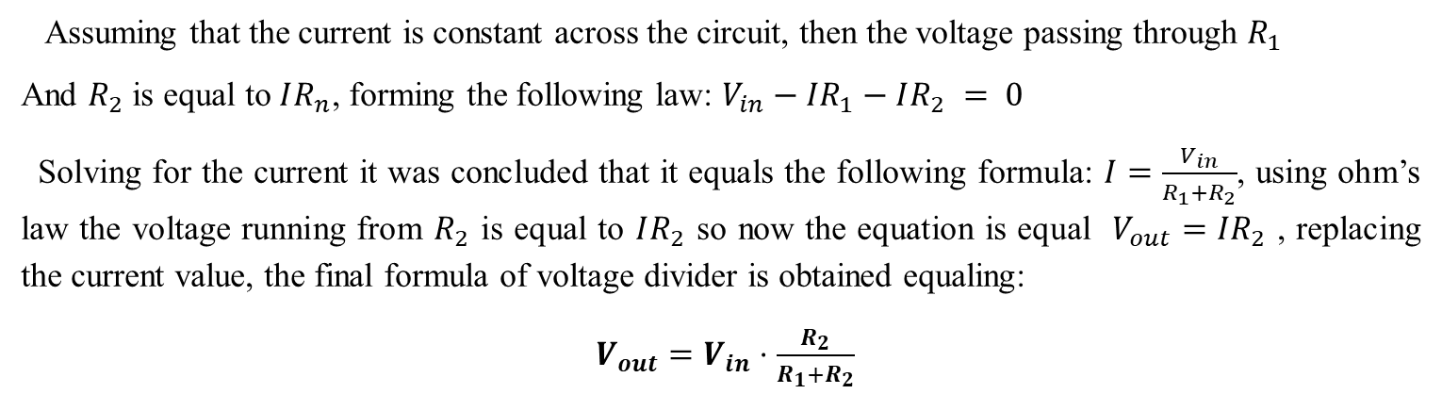





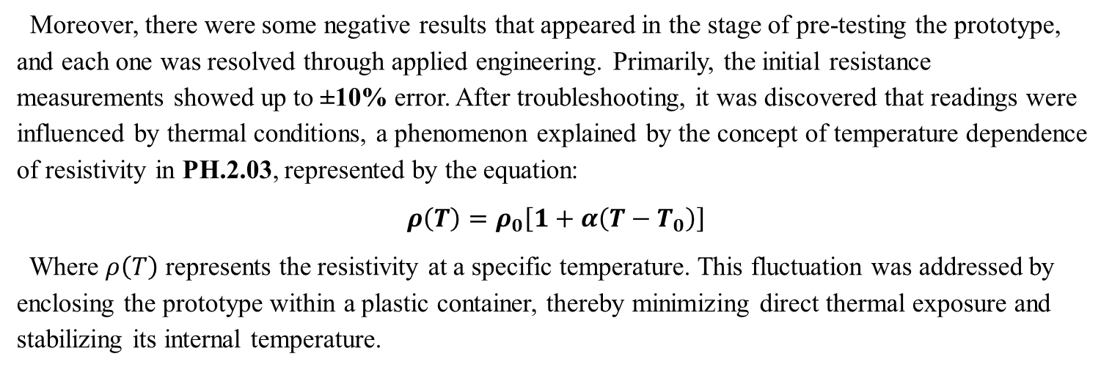
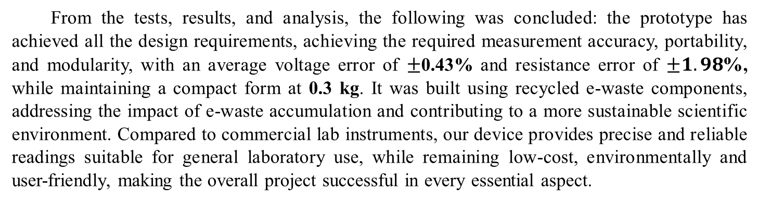
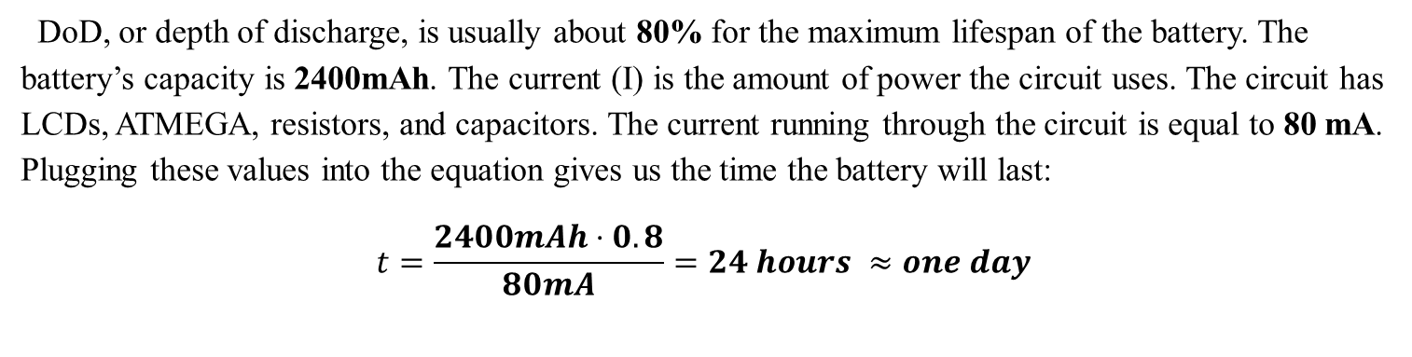
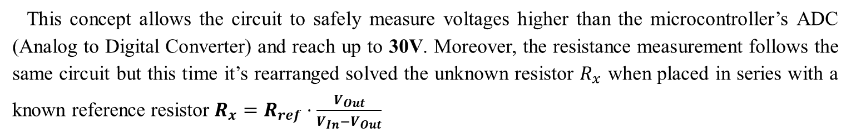
Development of an ATmega-driven multimeter from recycled E-waste materials
Mahmoud Walid, Mohamed Mohsen, Ziad Hossam, Ziad Masoud
Ismailia STEM- Grade 11- Semester 1- 2025/2026- G17207
Keywords: ATmega328p – E-waste – Kirchhoff’s law – Multimeter – Recycling - Resistance
Abstract
Analysis
Conclusion
Voltameter methods
. In the third test the system could recognize all the gestures right without any error or confusion between two gestures resulting in an accuracy of 100%.
This study aims to contribute to addressing multiple of Egypt’s Grand Challenges, most notably focusing on issues such as the e-waste accumulation, pollution, and the rising cost of laboratory instruments. The core objective of this research is to provide an affordable and eco-friendly alternative. An innovative multi-measurement device combining an ohmmeter and voltameter was designed, constructed, and tested. The system uses an ATmega microcontroller, an LCD interface, and circuits built entirely from recycled e-waste material, housed in a transparent protective casing. The prototype successfully satisfies key design requirements such as portability, multifunctionality, and a maximum error of ±5%. Moreover, testing demonstrated high measurement accuracy, achieving an average error of 0.43% voltage and 1.98% in resistance. Using those readings, current and power can also be calculated through Ohm’s law. The results confirm that this solution offers reliable performance, environmental benefits, and scalability, making it suitable for shared laboratories and scientific applications.
Methods
The prototype was carried out as follows:
The ATmega328p chip was inserted into the breadboard
A 16MHz crystal is connected between pins 9 and 10, with a 22pF
capacitor in series with the GND rail
A rest button with connects with a 10k$Ω$ resistor to GND and the
The other pin connected to the ATmega328p reset pin
The voltage regulator was connected to the breadboard, such that
The input and the ground pin are connected to the power source,
and the output is connected to the positive rail to power up
The ATmega chip, as shown in Fig 3
Two capacitors were connected in parallel with the voltage regulator
A debug LED was connected to the ATmega chip with a
220$Ω$ resistor
Then the voltage circuit was constructed as follows, as shown in Fig 4:
Connect two resistors with known values in series
Connect the end of the first resistor to the GND
Connect the second resistor to the PD0 pin in the A TMEGA
to read out ADC values
Connect the junction between the two resistors with the PC0 digital pin to read values
Lastly, the resistance circuit was followed by as shown in Fig 5.
Connect three known resistors with known values in parallel
Connect the first resistor to the GND
Connect each resistor to different digital pins PD6, PD5, and PD4
Connect the last resistor to the PC1
Connect the unknown resistor in parallel with the others to be
measured
Reducing e-waste and assisting in enhancing the scientific and technical environment for everyone, this prototype tackles two important problems mentioned in Egypt’s Grand Challenges. There are two main aspects of the issue. First, many schools and communities are still unable to afford high-quality laboratory equipment, leaving a gap in scientific education and creativity. Second, dangerous materials from the accumulation of electronic waste in landfills pollute groundwater and soil, posing a long-term threat to human health.
From the tests, results, and analysis, the following was concluded: the prototype has achieved all the design requirements, achieving the required measurement accuracy, portability, and modularity, with an average voltage error of $±$0.43% and resistance error of $±1.98$%, while maintaining a compact form at 0.3 kg. It was built using recycled e-waste components, addressing the impact of e-waste accumulation and contributing to a more sustainable scientific environment. Compared to commercial lab instruments, our device provides precise and reliable readings suitable for general laboratory use, while remaining low-cost, environmentally and user-friendly, making the overall project successful in every essential aspect.
The prototype offers sustainable solutions that reduce gaps in scientific
instruments while utilizing e-waste from the environment by building a
precision multimeter entirely from e-waste as shown in Fig 7.
Figure 3: A schematic diagram of the whole prototype
The prototype’s main scientific base is developed on the concept of a voltage divider, and PH.2.04 to relationships from Kirchhoff’s voltage law. Where the core measurement circuit consists of a resistor ladder network as shown in Fig 8, Kirchhoff’s law states that the voltage summation across the circuit is equal to zero:
$$\sum{V} = 0$$
Figure 7: Represents an image of the prototype
Recommendations
Introduction
re known as Egypt's Grand Challenges. Among these three are especially critical: Improving the scientific and technological environment, reduce pollution in air, Water, and soil, and recycling garbage. One of the primary contributors to these problems is the rising cost of labs and the growing collection of electronic waste.
Figure 8: Represents Kirkoff's voltage law
After completing the project, the prototype fulfilled all the design requirements, and the project produced effective and great results. However, there are certain suggestions that must be incorporated if the project is carried out in the future to increase its effectiveness and yield better results.
Using a cooling system helps to prevent any future reading problems caused by the component’s internal temperature
Creating a simulation to help users build their own prototype from e-waste components
Increasing the efficiency of the components by using new resistors and capacitors
Replacing the ATMEGA chip with an ESP-32, allowing the prototype to produce useful graphs and insights in a website dashboard
Using OLED displays to produce real-time graphs
Using solar panels as a renewable energy source for recharging the battery
Expanding the prototype to be a large-scale hybrid energy monitoring system in factories, research labs, and smart buildings
Implementing a low-power sleep mode to extend and increase the battery’s lifetime, to enable long-term usage of the device.
There are many obstacles that slow the pace of Egypt’s development, known as Egypt’s Grand Challenges. Among these, there are three critical ones: Improving the scientific and technological environment, reducing pollution in air, water, and soil, and recycling garbage. The contributors to these problems are many primarily the main problem is the rising cost of labs and the accumulation of e-waste in landfills.
Assuming that the current is constant across the circuit, then the voltage passing through $R_{1}$
And $R_{2}$ is equal to $IR_{n}$, forming the following law: $V_{in}−IR_{1}−IR_{2} = 0$
Solving for the current it was concluded that it equals the following formula: $I=\frac{V_{in}}{R_{1}+R_{2}}$, using ohm’s law the voltage running from $R_{2}$ is equal to $IR_{2}$ so now the equation is equal $V_{out}=IR_{2}$ , replacing the current value, the final formula of voltage divider is obtained equaling:
$V_{out}=V_{in}⋅\frac{R_{2}}{R_{1}+R_{2}}$
Figure 4: A picture illustrates how to make the voltameter circuit
As illustrated in Fig 1, laboratory equipment costs have increased globally, with prices rising by an estimated 38% in just the past few years. In Egypt, this issue had been even more magnified, due to the devaluation of the Egyptian Pound as inflation peaked at 31.95% in June 2017 (El Baradei, 2019, p. 312). These factors have made lab equipment unavailable for many schools, stopping the development of Egypt’s scientific and technological base.
Figure 1: A graph that shows how much the laboratory costs have increased
This concept allows the circuit to safely measure voltages higher than the microcontroller’s ADC (Analog to Digital Converter) and reach up to 30V. Moreover, the resistance measurement follows the same circuit but this time it’s rearranged solved the unknown resistor $R_{x}$ when placed in series with a known reference resistor $R_{x}=R_{ref}⋅\frac{V_{Out}}{V_{In}−V_{Out}}$
To address these problems, countries and companies have made large-scale projects that decrease the percentage of laboratory costs and the growing collection of electronic waste. To illustrate the ready-made Arduino lab kits that can be used in experiments or labs. Despite its benefits for demonstration being user-friendly, simple, and very cheap, there are significant disadvantages, including the lack of high precision, as it is not reliable for high-precision engineering numbers or advanced scientific research.
Figure 5: A picture illustrates how to make the ohmmeter circuit
Test plan
Calculate the resistance and voltage using a known reference against a multimeter and our prototype
Replacing a component to determine whether it achieved the modular design or not
Using the battery until drained and using the recharge module to confirm rechargeability
Testing the overcurrent protection by shorting the circuit and verifying that the fuses blow
The prototype mass was measured to determine whether it achieved the compact design or not (Mass < 0.5Kg)
Many factors affect the precision and accuracy of measurements; the two critical factors are reference resistors used in the voltage ladder, and the accuracy of voltage readings, both could be fixed using calibration.
After tests, the prototype showed both positive and negative results. Positive results are as follows. The prototype worked accurately enough to meet the design goals, proving that e-waste can be used again to build a scientific tool. Moreover, after recording the voltage measurements, the average error was 0.43%, and for resistance, it was 1.98%. Both errors were well under the ±5% limit. This performance is nearly like regular multimeters, which are usually much more expensive. Also, the device is easy to carry, weighing only 0.3 kg. It can charge and discharge its lithium-ion batteries, and it can run for one day, which was calculated using the following formula:
t$=\frac{C⋅DoD}{I_{Load}}$
Moreover, AMP Robotics is led by AMP Corporation. This company recycles old electronics parts and turns them into robotics components by robotics that work using artificial intelligence. AMP’s system is a powerful mix of artificial intelligence and high-speed robotics. Its limitation lies in high initial cost and complexity, though it is more reliable than humans. Robots are complex machines that require special technical staff for maintenance.
literature cited
Before defining the selected solution, clear design requirements were established to determine the success of the solution. The device is needed to produce a reliable, accurate output, limited to 5% error percentage. Furthermore, all the materials of the device are recycled and environmentally friendly, the transparent housing protects the device, has a variety of applications, and the device is scalable and portable. Making it a reliable instrument that could be used anytime, anywhere, and produce precise output.
Results
Caruso, M., Castiglia, V., Pizzo, A. D., Miceli, R., Salles, M., Schettino, G., Traversa, V., & Viola, F. (2017). Low-cost smart energy managment based on ATmega 328P-PU microcontroller. 13, 1204–1209. https://doi.org/10.1109/icrera.2017.8191244
Horowitz, P., & Hill, W. (2015). The art of electronics (3rd ed.). Cambridge University Press
Kushner, D. (2011, October 26). The Making of Arduino. IEEE Spectrum. https://spectrum.ieee.org/the-making-of-arduino
Ohm's Law. (2016). Ohm’s Law - University Physics Volume 2 - OpenStax. Openstax.org. https://openstax.org/books/university-physics-volume-2/pages/9-4-ohms-law
United Nations. (2022, May 6). Science, Technologies Can Transform Global Challenges, But Need to Be Accessible to All, Senior Officials Stress, as Economic and Social CouncilForumConcludePress.Press.un.org.
https://press.un.org/en/2022/ecosoc7083.doc.htm
WHO. (2024, October 1). Electronic waste (e-waste). Who.int; World Health Organization: WHO. https://www.who.int/news-room/fact-sheets/detail/electronic-waste-%28e-waste%29
DoD, or depth of discharge, is usually about 80% for the maximum lifespan of the battery. The battery’s capacity is 2400mAh. The current (I) is the amount of power the circuit uses. The circuit has LCDs, ATMEGA, resistors, and capacitors. The current running through the circuit is equal to 80 mA. Plugging these values into the equation gives us the time the battery will last:
$$t=\frac{2400mAh⋅0.8}{80mA}=24 hours ≈one day$$
After constructing the prototype, measurements were taken for both voltage and resistance. The results were recorded in Table 2 and Table 3. Calibration was performed using a digital multimeter with stated accuracy of (±0.5% + 2) for voltage and (±0.8% + 2) for resistance. Through repeated calibration and careful component selection from e-waste sources, the prototype successfully achieved measurement precision comparable to commercial instruments.
Table 2: Results of the voltameter circuit
Using those design requirements as a base to select the solution, a hybrid solution was selected that combines both the functions of an ohmmeter and a voltameter, as shown in Fig 2. The solution works using two circuits of both an ohmmeter and a voltameter, connecting them in a breadboard, uploading the code on the microcontroller to operate it. Using an LCD to show results on it. By integrating these two functions into a single eco-friendly device. The solution addresses Egypt’s Grand Challenges by offering a cheap, scalable, and recycled material device.
Trial | Reference (V) | Reading (V) | Error (absolute)
1 | 9 | 9.009 | 0.009
2 | 9 | 8.962 | 0.038
3 | 9 | 8.985 | 0.015
4 | 9 | 8.938 | 0.062
5 | 9 | 8.927 | 0.073
Total | 45 | 0.197
Moreover, there were some negative results that appeared in the stage of pre-testing the prototype, and each one was resolved through applied engineering. Primarily, the initial resistance measurements showed up to ±10% error. After troubleshooting, it was discovered that readings were influenced by thermal conditions, a phenomenon explained by the concept of temperature dependence of resistivity in PH.2.03, represented by the equation:
$ρ\left(T\right)=ρ_{0}\left[1+α\left(T−T_{0}\right)\right]$
Where $ρ\left(T\right)$ represents the resistivity at a specific temperature. This fluctuation was addressed by enclosing the prototype within a plastic container, thereby minimizing direct thermal exposure and stabilizing its internal temperature.
Figure 2: A picture of the chosen solution
The average absolute errors for voltage ($±$0.43%) and for resistance ($±1.98$%) were calculated by summing the absolute values of every individual trial error, then dividing them. The error lies within the calibrated multimeter’s uncertainty range, confirming that the prototype voltage readings are accurate and reliable.
Negative Results:
Resistance measurements got significant drift (±10%) when operating in direct sunlight or elevated temperature environments.
Table 3: Results of the ohmmeter circuit
Trial | Reference (Ω) | Reading(Ω) | Error (Absolute)
1 | 10000±1% | 10,160 | 160±100
2 | 10000±1% | 9,539 | 461±100
3 | 10000±1% | 9,927 | 73±100
4 | 5100±1% | 5,150 | 50±51
5 | 5100±1% | 5,150 | 50±51
Total | 40200 | 794
Materials and methods
Table 1: Materials
A further negative outcome was the variability in readings, this was caused due to the lack of uniformity in e-waste components, which resulted in an error margin greater than 8%. This issue was resolved by implementing MA.2.01, which involved establishing a linear function for the prototype calibration, utilizing the standard linear function for this purpose: $Y = mx + c$
And then solving to get the constants until the prototype is calibrated, taking the reference point as a calibrated multimeter as follows.
$${ R}_{cal}=\text{Calibration} \text{Scale}⋅R_{raw}+\text{Calibration} \text{Offset}$$ This mathematical correction reduced the average resistance, as shown in
Fig 9, by 68.8% as shown in the following equation by applying PH.1.01.
$$\text{Error} \text{Reduction}=\frac{\left|\text{Uncalibrated} \text{Error}−\text{Calibrated} \text{Error}\right|}{\text{Uncalibrated} \text{Error}}$$
Acknowledgment
Regular alkaline batteries drop voltage too often, causing measurement errors reaching up to (±5%).
Positive Results:
The prototype successfully achieved accurate and precise
readings compared to a multimeter, as shown in Fig 6.
2. Modular design has been implemented, enabling all
components to be replaced or upgraded using e-waste parts.
The final prototype meets the portability requirements,
weighing only ≈0.3Kg and operating from a rechargeable
Li-ion battery.
Addressing these negative results, the prototype was enclosed in a plastic housing to reduce any thermal fluctuations, and the power supply was upgraded to a Li-ion battery recovered from an RC car, eliminating any instability caused by alkaline cells.
Special thanks are extended to Ms. Noha Naguib (Capstone leader), Ms. Marwa Mourad (School manager), Ms. Eman Elshabrawy ( Fabrication lab teacher ), Mr. Ahmed Nafea ( School deputy ) and Mr. Abdelrahman Aboud ( Capstone teacher) for their efforts with us.
Figure 9: Represents uncalibrated versus calibrated results
For further information
Figure 6: represents the device measurements versus the multimeter measurements
In summary, an additional problem was the inconsistent power supply when operating the prototype with alkaline batteries. This instability in voltage measurements led to inaccurate readings by the analog-to-digital converter (ADC), resulting in errors as high as 5%. This issue was resolved by using CH.1.14 to study electrochemical characteristics of batteries. Specifically, a Li-ion battery was extracted from an old RC car. This modification ensured a more stable output voltage and, more importantly, made the prototype portable by utilizing a rechargeable battery.
Mahmoud Walid Farag
Mohamed Mohsen Mahamoud
Ziad Hossam Ramadan
Ziad Masoud Khalaf
Mahmoud.1724025@stemismailia.moe.edu.eg
Mohamed.1724037@stemismailia.moe.edu.eg
Ziad.1724061@stemismailia.moe.edu.eg
ziad.1724062@stemismailia.moe.edu.eg

